Slide 1

Creating ICSM Compliant ISO19115-3 Metadata
With ANZMet Lite V2
Byron Cochrane & Liz Kolster
Notes:
5 minutes to settle
House keeping talk

Slide 2

Workshop Agenda:
Creating ICSM Compliant ISO19115-3 Metadata
Introductions
Plus - Intro to FAIR, MDWG, ISO19115-1
Tour of ANZMet Lite V2
Exercises 1 -3
BREAK
Intro to ISO 19157 - Data Quality Metadata
Exercises 4-6
Close - What’s Next for GeoSpatial Metadata
Notes:
5 minutes
Reformat to match sections

Slide 3
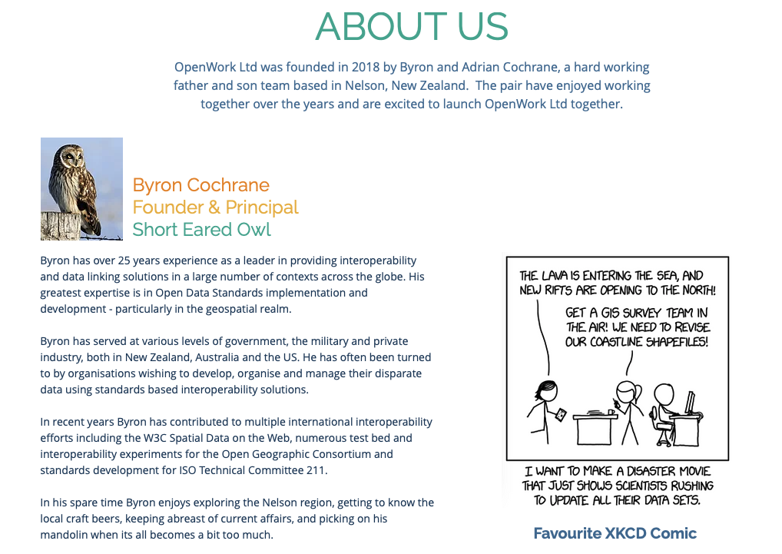
Notes:
Myself - Brief Bio
Others - Around the group
Stories about metadata - or what you want from metadata
Capture particular questions and desires on post-its
Close with Liz intro

Slide 4
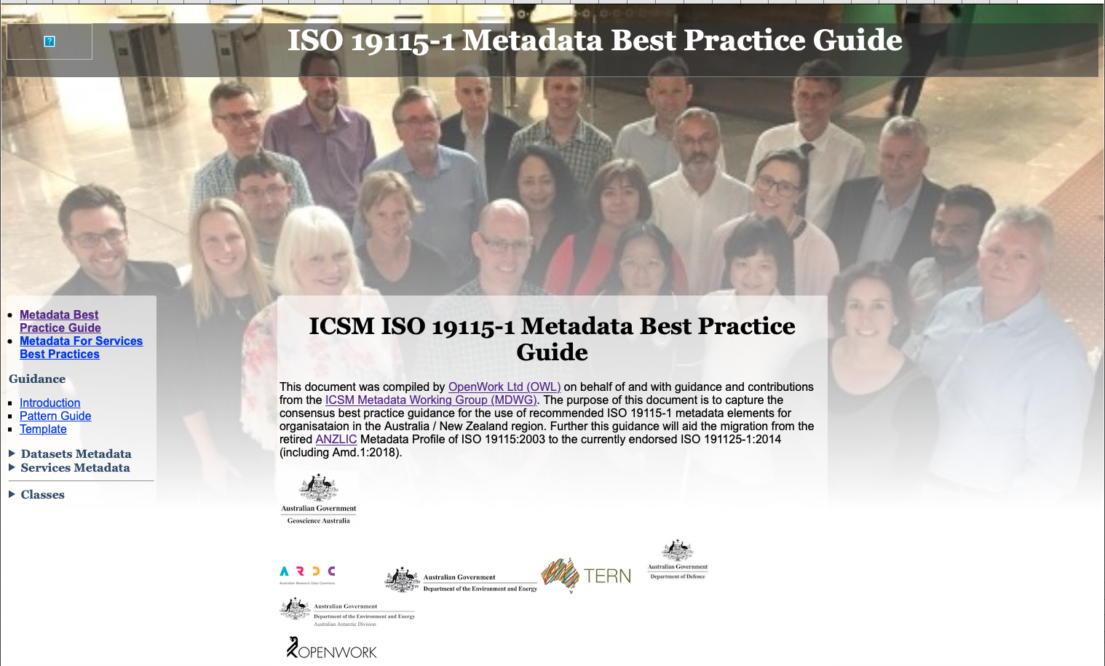

Slide 5
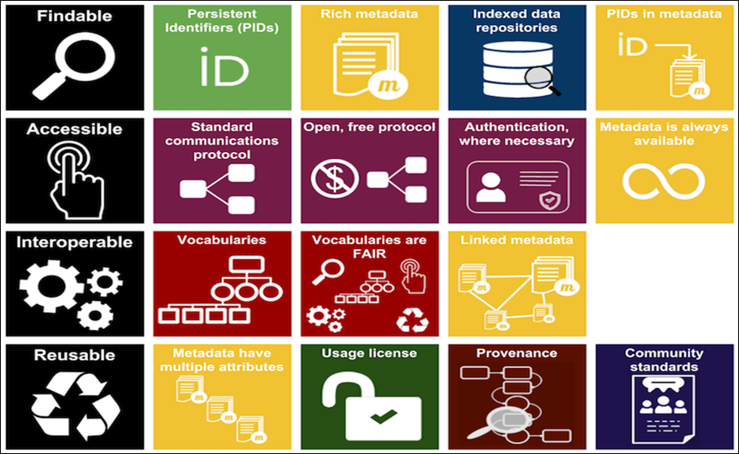
FAIR Implementation Principles
Framework based on standards, published in 2015
Cover data, vocabularies, services, …
Applicable to any domain or discipline
Focus on share to enable maximum reuse
Emphasise machine-actionability
Highlight importance of fit for purpose metadata
https://www.go-fair.org/fair-principles
Findable: (Meta)data - findable by humans and computers; globally unique persistent identifiers (PID) for metadata statements and described resource (e.g. dataset); searchable resource. Data have rich metadata.
Accessible: (Meta)data - retrievable by PIDs; use standardised communications protocol (universally implementable); allows authentication/authorisation. Metadata is accessible, even when the data is not.
Interoperable (Meta)data - use broadly applicable language for knowledge representation; use data dictionaries and vocabularies; (meta)data by using PIDs.
Reusable: (Meta)data - richly described and fit for purpose; known license and other constraints; detailed provenance; meet domain-relevant community standards.
Notes:
About
Fair
Projects and Plans
Getting involved - ICSM, Standards NZ, Richards Committee, OGC

Slide 6
ISO Geospatial Metadata
The ISO19115 family tree
ISO TC211 - Geographic information/Geomatics
ISO19115:2003 & ISO19139
ANZLIC Metadatat Profile v1.1 - 2007
ISO19119 Geographic information — Services
ISO 19110:2016 Methodology for Feature Cataloguing
ISO19115-1:2014, amd.1:2018 and amd.2-2020 - not backwards compatible
ISO19115-3:2016 Geographic information — Metadata — Part 3: XML schema implementation for fundamental concepts
Notes:
5 minutes
A brief history of the ISO 19115 metadata standard with a focus on ANZLIC and MDWG

Slide 7
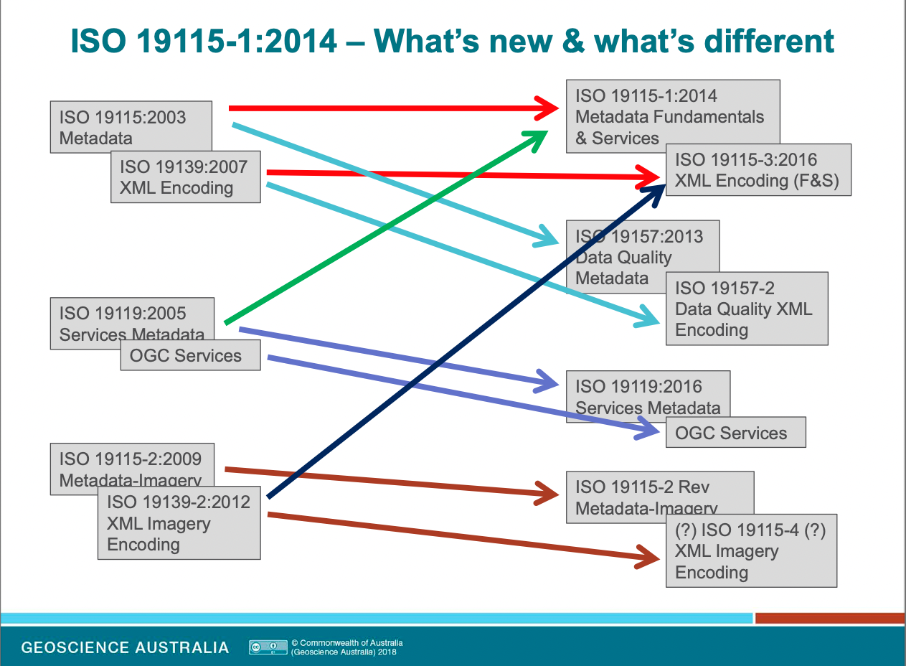
Metadata for services
Bi-directional linking of services and datasets
Horizontal linking with associated resources
Improved constraints information
Semantic web enablement (Identifiers and Keywords)
Removal of data quality element information (completeness, accuracy, etc.)

Slide 8
ISO19115-1:2014/amd.1:2018
And MDWG work
Focus of ICSM MDWG Work
Small “p” profile - schema does not vary.
Additional Guidance on usage
ANZMet Lite V2 - the tool we will use today based on amd.1:2018
incorporates changes from ISO19115-1:2014
Notes:
5 minutes
Deep dive into this version because it is the one that we will be using - ANZMet Lite V2 is built around

Slide 9
ISO19115-1 amd.2-2020
Dynamic Datum Support
To support Coordinate drift
and deformation models
Not yet in ISO19115-3
So a cludge in editing tools
Based on ISO19111:2019
Conceptual model
Notes:
5 minutes
Sort discussion of this standard and what it does different
Next Version? Work in progress. Other related standards, London Event

Slide 10
Other Related Standards & Tools
Ongoing Metadata Efforts
Other Common Geospatial metadata standards and tools (not 19115-3 friendly)
CKAN, Koordinates, pyCSW, ArcGIS
Other Common Geospatial metadata and catalogue standards
STAC, OGC API Records, GeoDCAT, ISO/IEC 11179
ISO 19157 Geographic information — Data quality - Liz Kolster
2022 Joint OGC & ISO/TC 211 Code Sprint, aka The Metadata Code Sprint
Other ongoing activities, MDWG, ISO, OGC and Other
Notes:
5 min
Base emphasis on earlier comments
Take questions here

Slide 11
Tour of ANZMet Lite V2

Slide 12
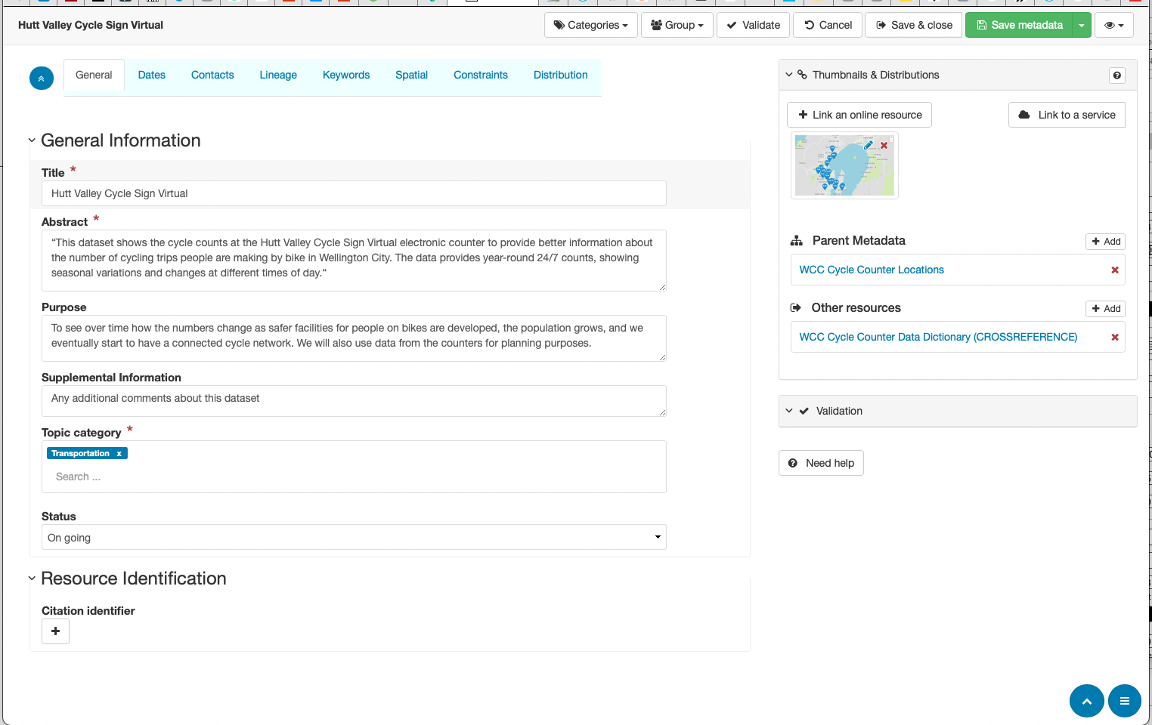
ANZMet Lite V2
GeoNetwork opensource v12.6
What is ANZMet Lite V2 -(insert image of old ANZMet Lite)
Replacement to ANZMet Lite
Windows app
Not open source, could not be customised, hard to update
ANZLIC Profile of ISO19115 (ISO19139)
Geonetwork platform - Version 3.10.6
Web based
Open source
Notes:
Load a standard geonetwork on my machine for demo of differences
10 minute tour of GeoNetwork
10 minutes ANZMet Lite V2

Slide 13
GeoNetwork open source
Version 3.12.6
GeoNetwork basics
Template based
Multiple schema support
Publishing process
Installation and customisation
Harvesting - distributed
geodata.nz

Slide 14
ANZMet Lite V2 alterations
Specialised Tabs
Sections modified
Simplified linkings
Link to custom help
Improved use of Managed Directories
Notes:
Walk through the editor interface

Slide 15
Exercises

Slide 16
Scenario
And Resources
We want some data to do some analysis of cycling in Wellington but the data available is not in the structure we need. We need both suitable data and adequate metadata for documentation
Data sources
Cycling data from Koordinates - GeoPackage in EPSG:4326 with limited metadata
Cycle counter sites -
GeoJSON feed scraped from WCC Transport Projects - Cycle count data page
Munge the data into proper GeoJSON
Scrape what metadata we can from the webpage
Cycle counts
Provided as a single CSV file (not okay for us) by year (okay)
Split into separate file for each counter location - Help us deal with individual counter quality issues in our study.

Slide 17
Demo - Create a Dataset Metadata Record
ANZMet Lite V2
Cycle Counter Locations in Wellington
Discuss where the data came from
Link to preprepared info sheet with statements gleaned from website and data
Walk through creation of metadata record
Create thumbnail
Notes:
Best way to understand is by creating metadata
Create Tutorial #1 pdf
10 minutes - make sure everyone is following

Slide 18
Hands on - Create Sensor Metadata
Using ANZMet Lite V2
Each Student choses a set of sensor data
Follow prepared tutorial
Use ICSM Dataset template (or prepared template?)
Note - Temporal data but not so much spatial except BBox
Compare results and discuss
Notes:
Tutorial #2
20 minutes to create
10 minutes to compare results

Slide 19
Demo - Create a Service Metadata Record
Using QGIS and GeoCat Bridge (modified)
Launch QGIS
Load Data - Cycle Routes in Wellington
Style data
Publish using GeoCat Bridge
Note - QGIS does not support ISO19115-3
Open in ANZMet Lite V2
Modify record with additional info
Notes:
there is a ArcGIS version of GeoCat Bridge as well - but not open source
Create tutorial #2
10 minutes

Slide 20
Break
Notes:
15 - 20 minutes depending how on time we are
Close out break with ICSM video about metadata

Slide 21

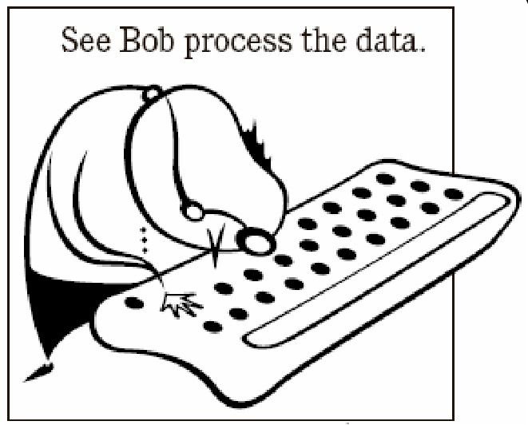
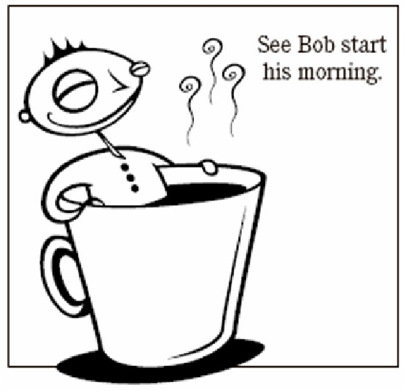
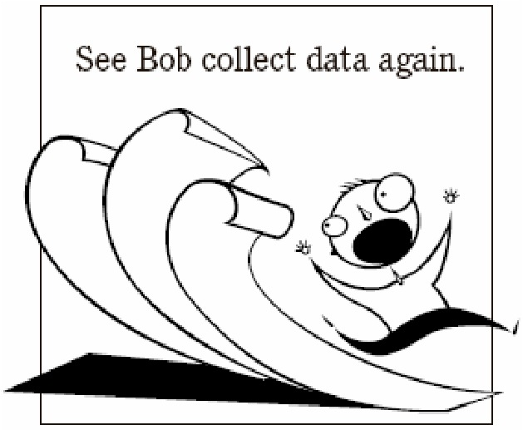
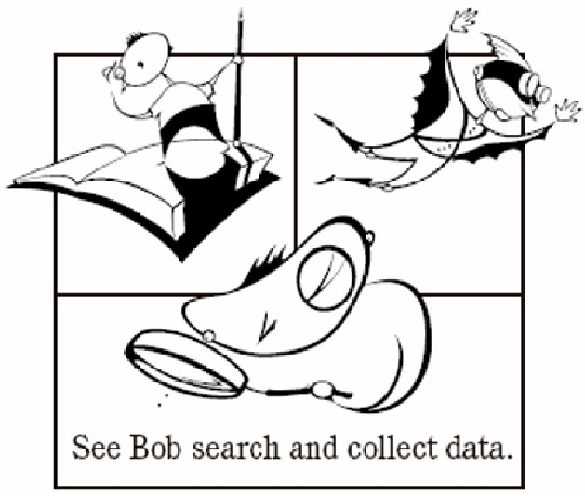


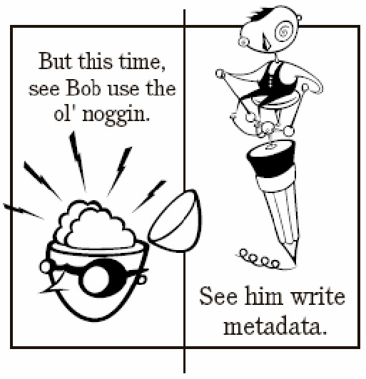


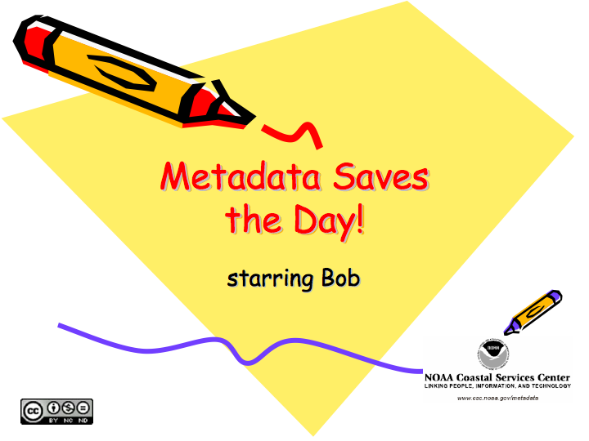

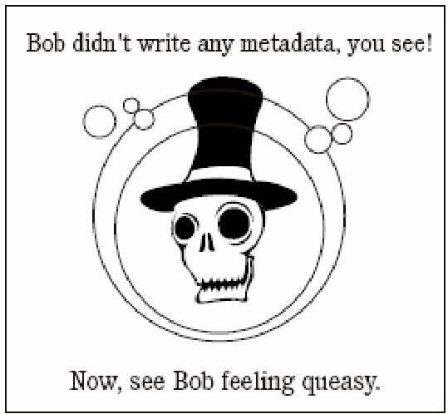



Notes:
Insert bubbly music

Slide 22
ISO19157 Data Quality
Liz Kolster
Relation to ISO19115-1 & 3
The Liz Kolster Show!
Past versions and recent work
Notes:
20 minutes

Slide 23
Hands on - Capturing Quality Aspects in Metadata
In GeoNetwork
Lead by Liz
Select previously created Cycle count metadata record
Follow prepared tutorial with needed quality statements
Open GeoNetwork in Advanced edit
Populate quality section accordingly
This will be done to the existing 19157 - not the new
Notes:
10 minutes

Slide 24
Demo - Create Data Dictionary Metadata
Using ANZMet Lite V2
New feature in ANZMet Lite V2 and still under dev
Illustrate two options
ISO19110 record - old way
ISO19115-3 record - new way?
Walk through Creating Data dictionary metadata for cycle counts
Discuss
Notes:
10 minutes

Slide 25
Hands on - Linking and Integrating Metadata
Demo - Link Count sites to Cycle paths metadata
Link Counts metadata to Data Dictionary
Link Counts metadata to Count sites metadata
Save changes
Notes:
10 minutes

Slide 26
Closing Slide
Fair Principles
Good Documentation (Data management) leads to many benefits - one of which is improved data discoverability
The single best way to improve the value of your resources is to document them
Remember the most important needs that metadata should serve are your own
https://www.go-fair.org/fair-principles

Slide 27
What questions do you have?
Byron Cochrane - Nelson, New Zealand - byron@openwork.nz - 021 794 501

Slide 28
What’s Next for GeoSpatial Metadata
Closing Discussion
Possible topics
Other approaches to metadata
STAC, OGC API Records, GeoDCAT, CKAN, Koordinates
More about ISO19157 Data Quality efforts
Geonetwork in more detail
Demo of Iwi-Cat - Ngati Rarua implementation of ANZMet Lite V2 for Taiao
Upcoming OGC Metadata Codesprint
Other topics - What Questions do you have?
Notes:
remaining time

